Slide 1
Cohort state-transition model variations in R
Using R for Decision Modeling in Health Technology Assessment
CE16
NIHES Erasmus Medical Center Rotterdam
February, 2020

Slide 2
Time varying probabilities

Slide 3
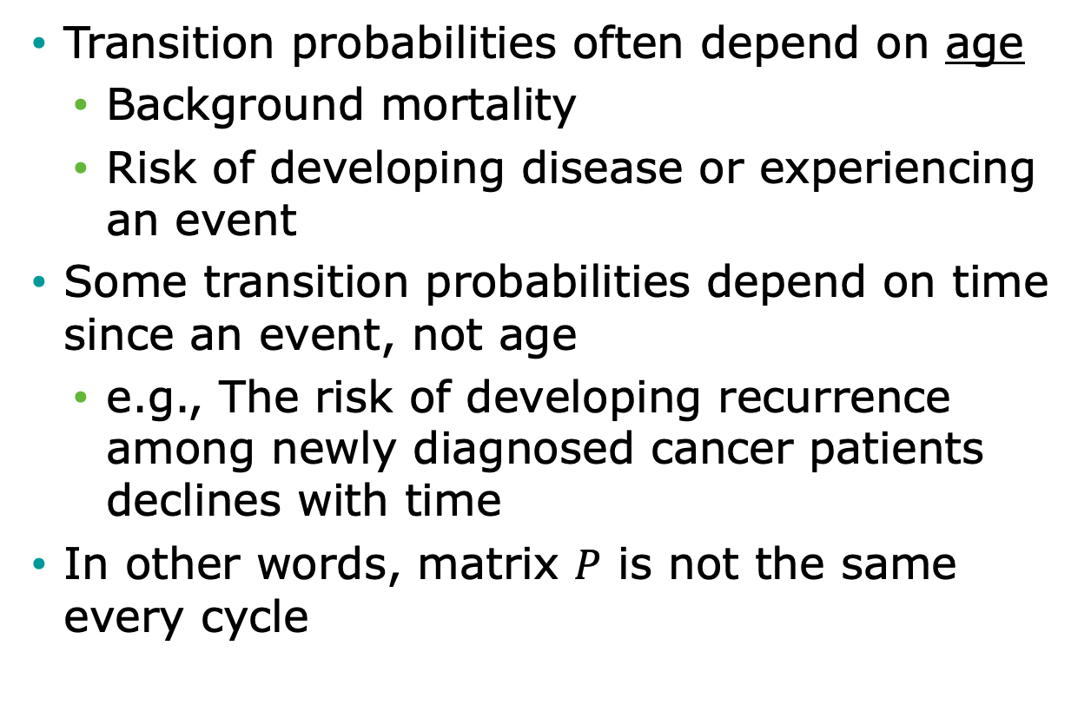
Time-varying probabilities
Transition probabilities often depend on age
Background mortality
Risk of developing disease or experiencing an event
Some transition probabilities depend on time since an event, not age
e.g., The risk of developing recurrence among newly diagnosed cancer patients declines with time
In other words, matrix $P$ is not the same every cycle

Slide 4
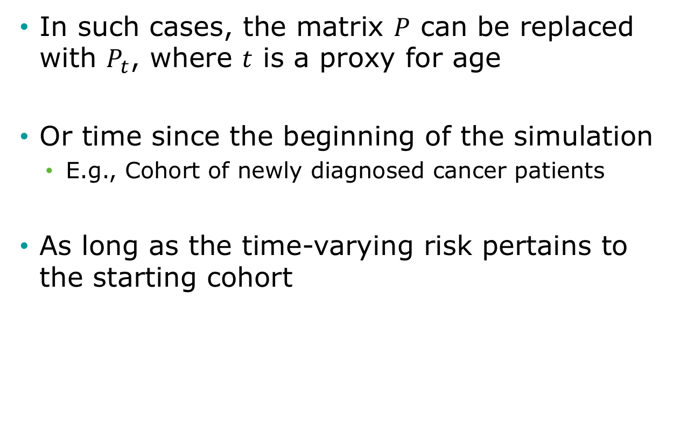
Time-varying probabilities
In such cases, the matrix $P$ can be replaced with $P_{t}$, where $t$ is a proxy for age
Or time since the beginning of the simulation
E.g., Cohort of newly diagnosed cancer patients
As long as the time-varying risk pertains to the starting cohort

Slide 5
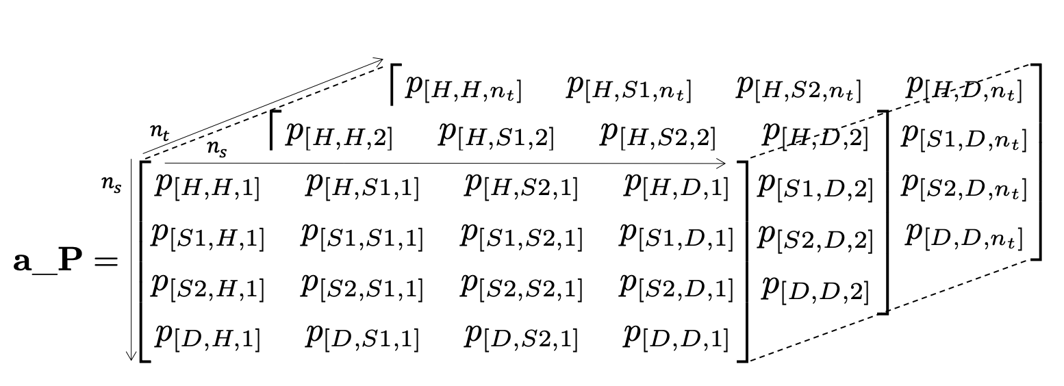
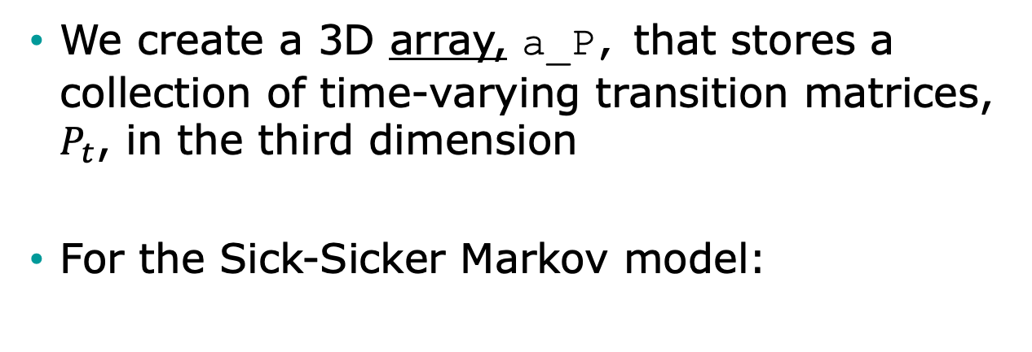
Time-varying probabilities in R
We create a 3D array, a_P, that stores a collection of time-varying transition matrices, $P_{t}$, in the third dimension
For the Sick-Sicker Markov model:

Slide 6
R Session

Slide 7
Time-dependent probabilities

Slide 8
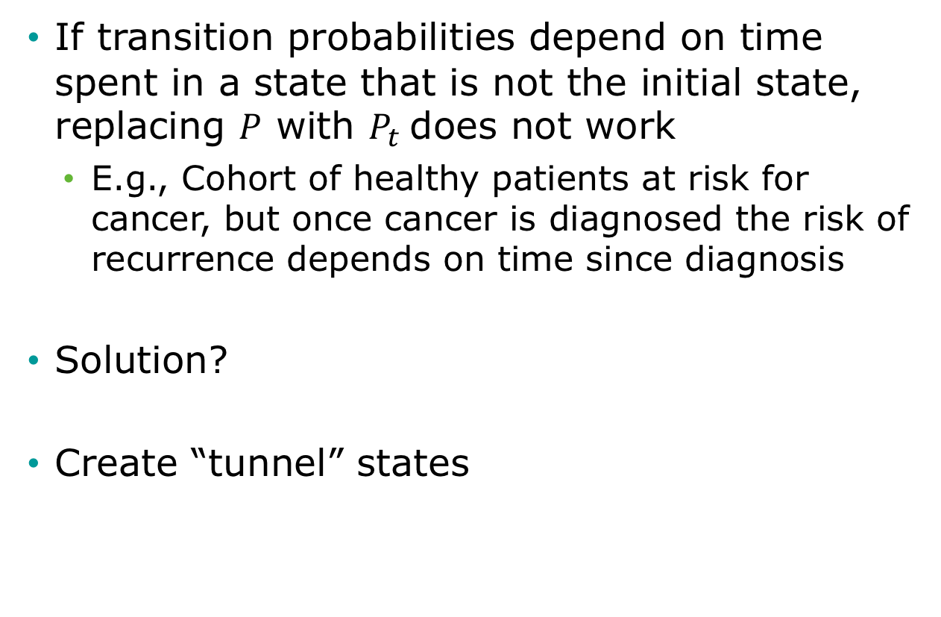
Time-Dependent Probabilities
If transition probabilities depend on time spent in a state that is not the initial state, replacing $P$ with $P_{t}$does not work
E.g., Cohort of healthy patients at risk for cancer, but once cancer is diagnosed the risk of recurrence depends on time since diagnosis
Solution?
Create “tunnel” states

Slide 9
State Time
f(model time)
f(state time)
Healthy
Cancer
Recur
Dead
Tunnel state

Slide 10
Tunnel States
pRecur₁
Cancer 1
pRecur₂
Cancer 2
pRecur₃
Cancer 3
Recur
pRecur₄
Cancer 4
pRecur_{n}
Cancer n
Transitions to Dead also allowed

Slide 11
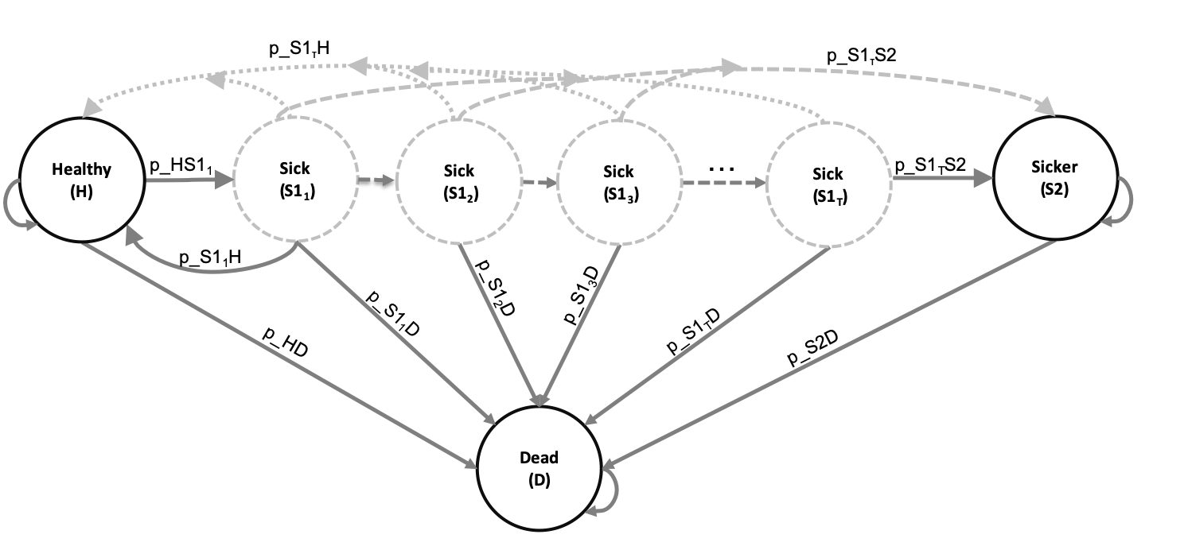
Time-dependent probabilities
Expand the states of the 3D array by the number of cycles considered in the time-dependency variable(s)
For the Sick-Sicker Markov model:

Slide 12
R Session

